Slide 1
Bitcoin price and tweets
Jennifer Dersjant

Slide 2
API Twitter
Limit of 150 per 15 minutes
1000 Tweets
Almost one full hour of tweets with the text query Bitcoin
Based on day, hour, second and microseconds

Slide 3
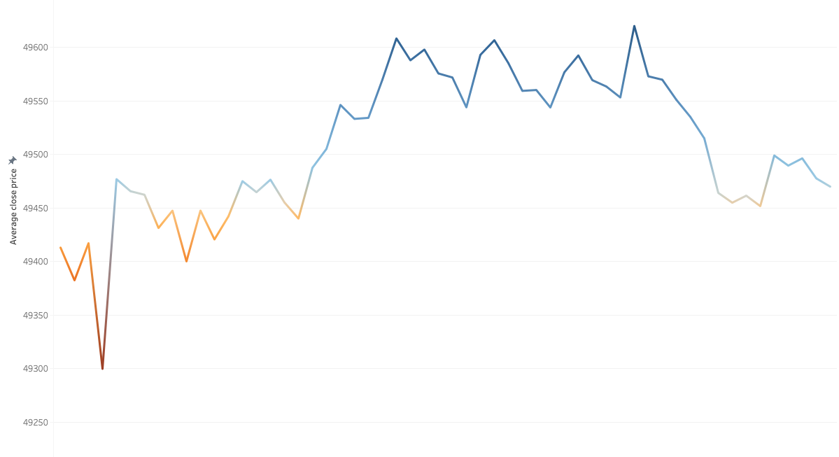
Bitcoin historic price data
Historic prices of BTC per minute
Managed to find 56 rows of data

Slide 4
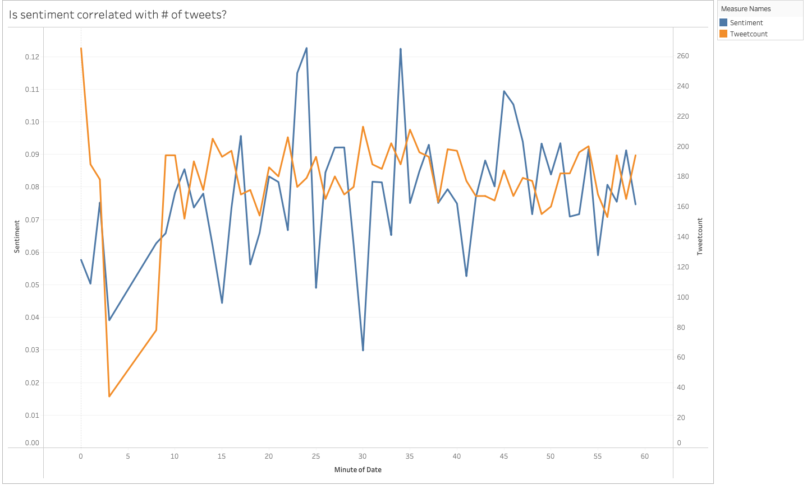
sentiment ANALYSIS
Sentiment based on polarity (avg. of 0.077)

Slide 5
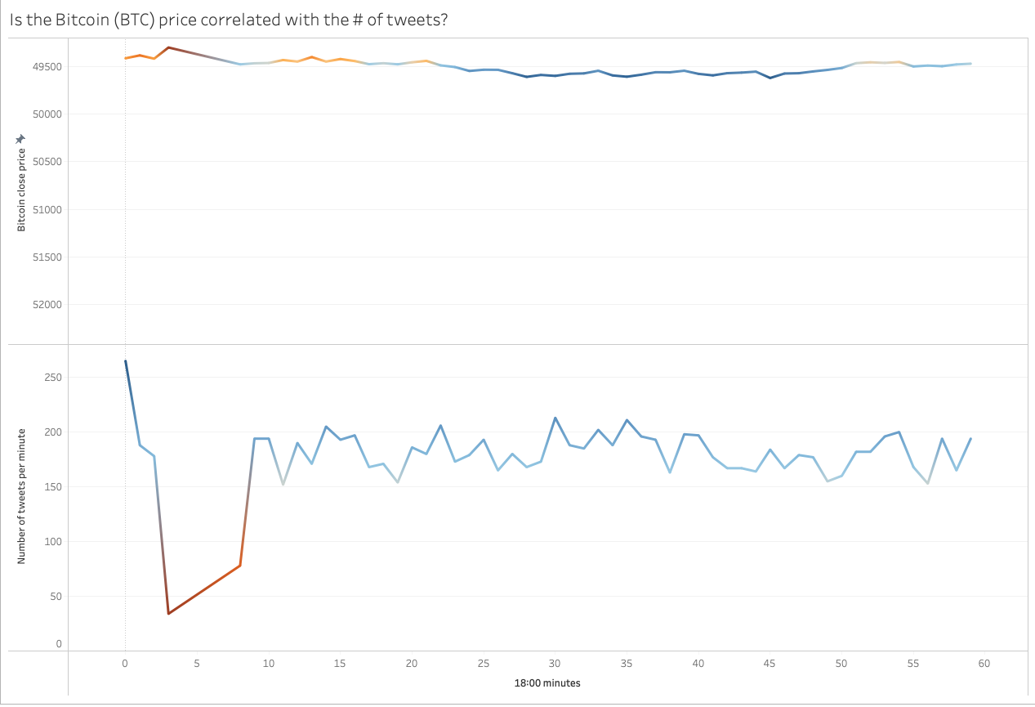
Correlations
Tweet count and closing price
0.23
Sentiment and closing price
0.36
0.21
F-Test

Slide 6
machine LEARNING
Normalized the descriptive variables
Applied a train test with 0.3 test size
R2 score
MAE
0.26
58.6

Slide 7
Improving OLS AND ML
Increase data
Add more descriptive variables
Time lag in tweets

